Slide 1
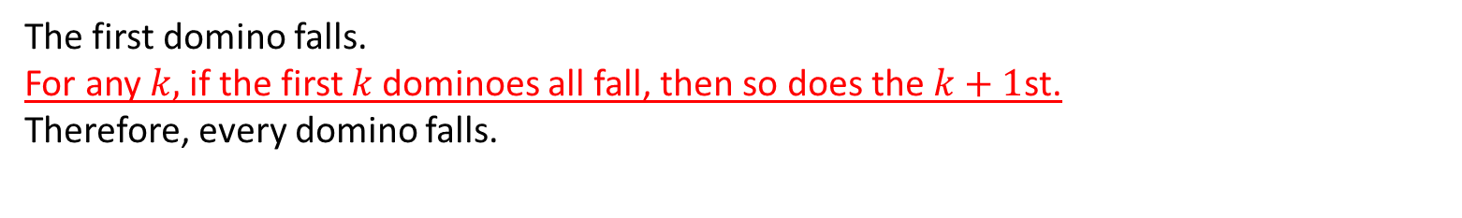
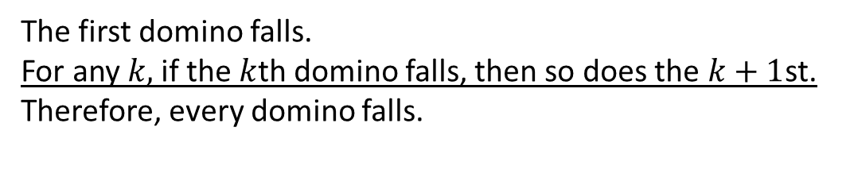
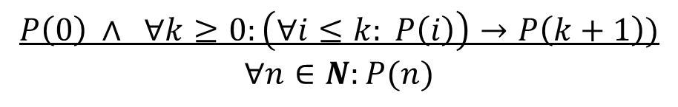
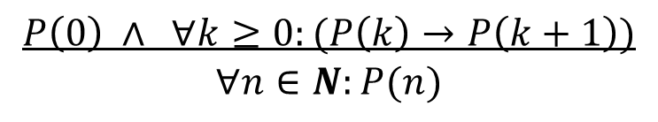
Another Look at Dominoes
The first domino falls.
For any $k,$if the $k$th domino falls, then so does the $k+1$st.
Therefore, every domino falls.
$$P\left(0\right) ∧ ∀k≥0:(P\left(k\right)→P\left(k+1\right))$$
$$∀n∈N:P(n)$$
The first domino falls.
For any $k,$if the first $k$dominoes all fall, then so does the $k+1$st.
Therefore, every domino falls.
$$P\left(0\right) ∧ ∀k≥0:\left(∀i≤k: P\left(i\right)\right)→P\left(k+1\right))$$
$$∀n∈N:P(n)$$
This is called proof by strong induction. The inductive hypothesis is stronger.
Every proof by strong induction can be recast as a proof by induction – logically the two proof techniques are equivalent.

Slide 2
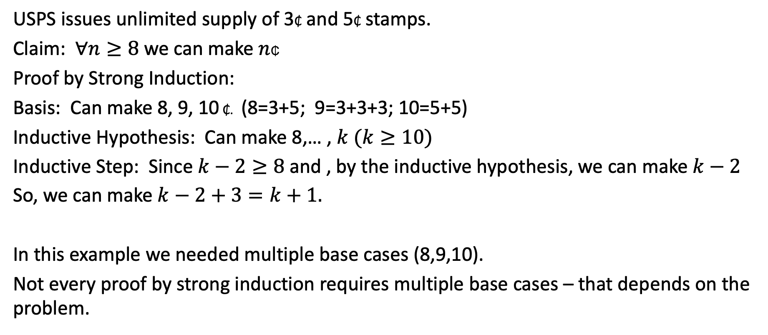
Proof by Strong Induction
USPS issues unlimited supply of 3₵ and 5₵ stamps.
Claim: $∀n≥8$we can make $n$₵
Proof by Strong Induction:
Basis: Can make 8, 9, 10 ₵. (8=3+5; 9=3+3+3; 10=5+5)
Inductive Hypothesis: Can make 8,… , $k (k≥10)$
Inductive Step: Since $k−2≥8$ and , by the inductive hypothesis, we can make $k−2$
So, we can make $k−2+3=k+1.$
In this example we needed multiple base cases (8,9,10).
Not every proof by strong induction requires multiple base cases – that depends on the problem.

Slide 3
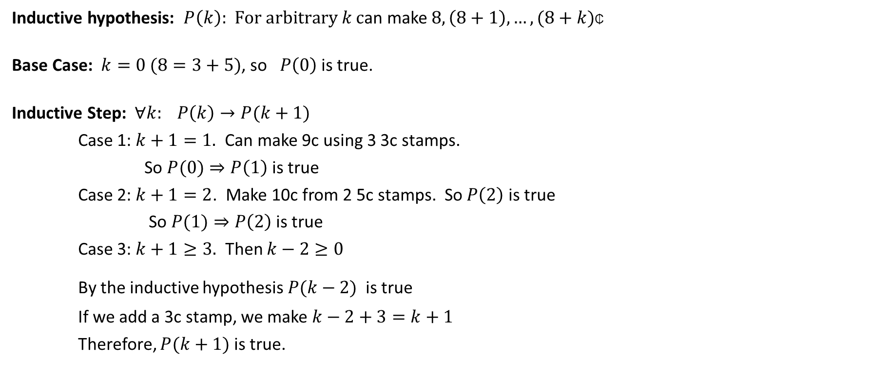
Alternative Proof by Induction
Inductive hypothesis: $P\left(k\right):$ $For arbitrary k c$an make $8,\left(8+1\right), …,(8+k)$₵
Base Case: $k=0 (8=3+5)$, so $P\left(0\right)$ is true.
Inductive Step: $∀k: P\left(k\right)→P(k+1)$
Case 1: $k+1=1.$ Can make 9c using 3 3c stamps.
So $P(0)⇒P\left(1\right)$ is true
Case 2: $k+1=2$. Make 10c from 2 5c stamps. So $P\left(2\right)$ is true
So $P(1)⇒P\left(2\right)$ is true
Case 3: $k+1≥3.$ Then $k−2≥0$
By the inductive hypothesis $P(k−2)$ is true
If we add a 3c stamp, we make $k−2+3=k+1$
Therefore, $P(k+1)$ is true.

Slide 4

Exercise
Find a simple formula for the sum: $\frac{1}{1∙2}+\frac{1}{2∙3}+\frac{1}{3∙4}+ ⋯+\frac{1}{n\left(n+1\right)}$
First ,let’s try out the first few numbers:
$n=1: \frac{1}{1∙2} = \frac{1}{2}$
$n=2:$ $\frac{1}{1∙2}+\frac{1}{2∙3}=\frac{3}{6}+\frac{1}{6}=\frac{2}{3}$
$n=3: \frac{1}{1∙2}+\frac{1}{2∙3}+\frac{1}{3∙4}=\frac{2}{3}+\frac{1}{12}=\frac{9}{12}=\frac{3}{4}$
$n=4: \frac{1}{1∙2}+\frac{1}{2∙3}+\frac{1}{3∙4}+\frac{1}{\left(4∙5\right)}=\frac{3}{4}+\frac{1}{20}=\frac{16}{20}=\frac{4}{5}$
Do you see a pattern?

Slide 5
Claim: $∀n≥1: \frac{1}{1∙2}+\frac{1}{2∙3}+\frac{1}{3∙4}+ ⋯+\frac{1}{n\left(n+1\right)}=\frac{n}{n+1}$
Proof by Induction:
Basis: $n=1. \frac{1}{1∙2}=\frac{1}{2}$
Inductive Hypothesis: $\frac{1}{1∙2}+\frac{1}{2∙3}+\frac{1}{3∙4}+ ⋯+\frac{1}{k\left(k+1\right)}=\frac{k}{k+1}, k≥1$
Inductive Step: $\frac{1}{1∙2}+\frac{1}{2∙3}+\frac{1}{3∙4}+ ⋯+\frac{1}{(k+1)\left(k+2\right)}$
$= \frac{1}{1∙2}+\frac{1}{2∙3}+\frac{1}{3∙4}+ ⋯+\frac{1}{k\left(k+1\right)}+\frac{1}{\left(k+1\right)\left(k+2\right)}$
$= \frac{k}{k+1}+\frac{1}{\left(k+1\right)\left(k+2\right)} = \frac{k\left(k+2\right)+1}{\left(k+1\right)\left(k+2\right)} = \frac{k^{2}+2k+1}{\left(k+1\right)\left(k+2\right) } = \frac{(k+1)(k+1)}{(k+1)(k+2)}$
$= \frac{k+1}{k+2}$
This establishes the inductive step!

Slide 6
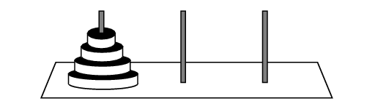
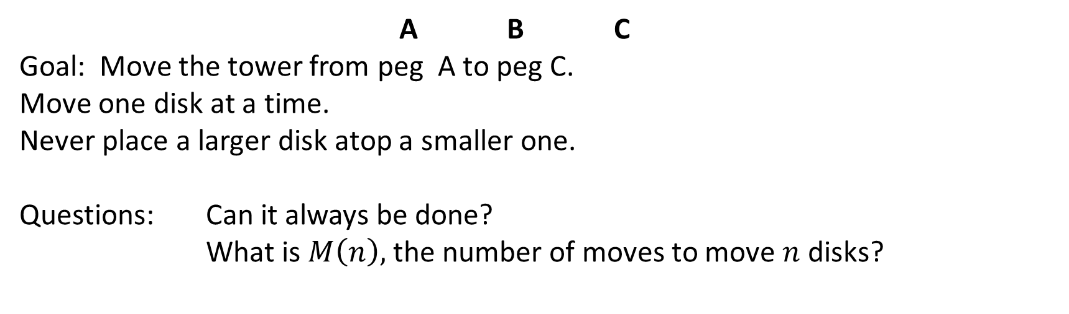
The Towers of Hanoi
A B C
Goal: Move the tower from peg A to peg C.
Move one disk at a time.
Never place a larger disk atop a smaller one.
Questions: Can it always be done?
What is $M\left(n\right),$ the number of moves to move $n$ disks?

Slide 7

The Towers of Hanoi
A B C
$M\left(1\right)=1$

Slide 8

The Towers of Hanoi
A B C
$M\left(2\right)=3$

Slide 9

The Towers of Hanoi
1
2
3
4
5
6
7
A B C
$$M\left(3\right)=7$$

Slide 10

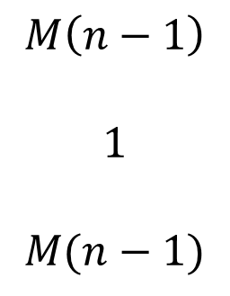
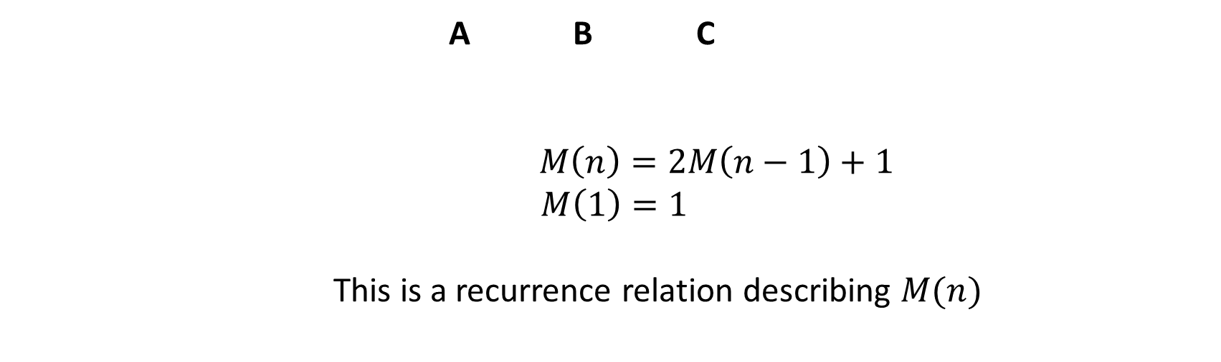
The Towers of Hanoi
$$M\left(n−1\right)$$
$$1$$
$$M(n−1)$$
A B C
$$M\left(n\right)=2M\left(n−1\right)+1$$
$$M\left(1\right)=1$$
This is a recurrence relation describing $M(n)$

Slide 11

The Towers of Hanoi
$$M\left(n\right)=2M\left(n−1\right)+1 \\ M\left(1\right)=1$$
Let’s calculate a few values:
$$M\left(1\right)=1 \\ M\left(2\right)=2∙1+1=3$$
$$M\left(3\right)=2∙3+1=7 \\ M\left(4\right)=2∙7+1=15 \\ M\left(5\right)=2∙15+1=31$$
This suggests $M\left(n\right)=2^{n}−1$

Slide 12

The Towers of Hanoi
$$M\left(n\right)=2M\left(n−1\right)+1 \\ M\left(1\right)=1$$
Claim: $∀n≥1 M(n)=2^{n}−1$
Basis: $n=1: M\left(1\right)=1=2^{1}−1$
Inductive Hypothesis: $M\left(k\right)=2^{k}−1$
Inductive Step: $M\left(k+1\right)=2M\left(k\right)+1$ $$=2∙\left(2^{k}−1\right)+1 \\ =2∙2^{k}−2+1 \\ =2^{k+1}−1$$

Slide 13
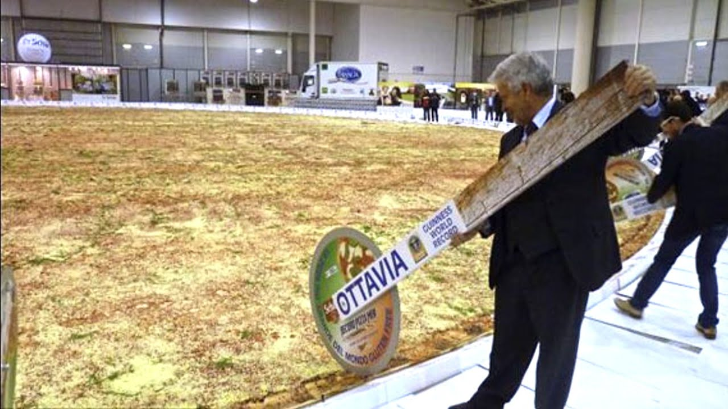
And Now for Something Completely Different!

Slide 14
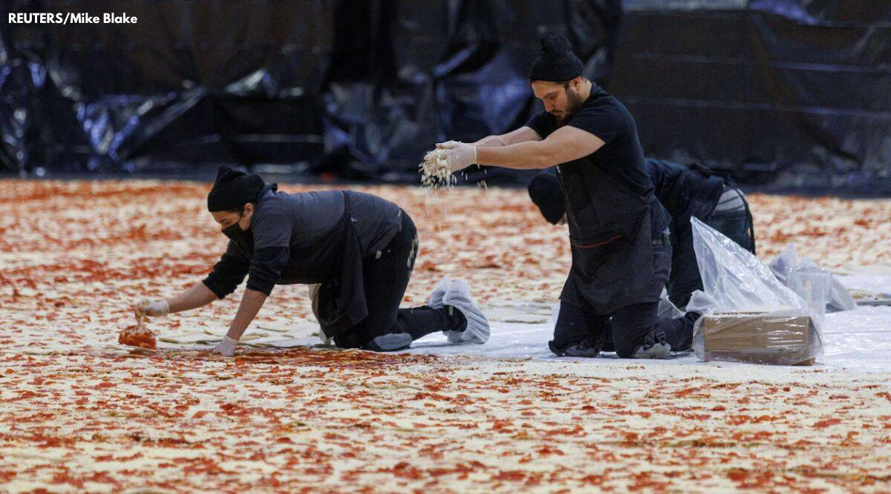
The Latest Record: Pizza Hut 2023

Slide 15
How many slices can we cut?
Every cut is a straight line.
Slices can be of different sizes.
Goal: Maximize the number of slices for a fixed number of cuts.
# cuts #slices
0 1
1 2
2 4
3 6
3 7

Slide 16
How many slices can we cut?
Goal: Maximize the number of slices for a fixed number of cuts.
# cuts #slices
0 1
1 2
2 4
3 7
4 11

Slide 17
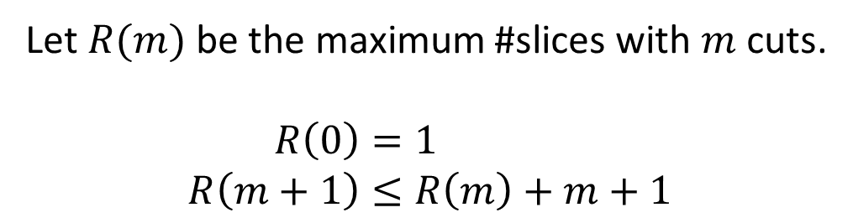
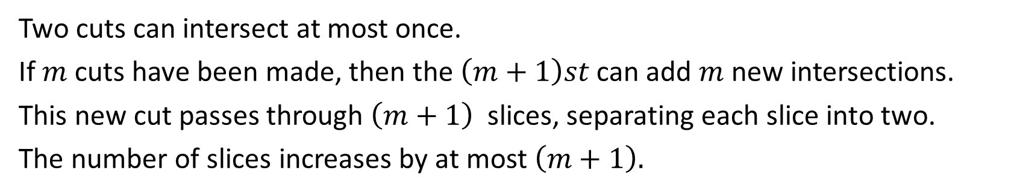
The Key Observation
Two cuts can intersect at most once.
If $m$ cuts have been made, then the $\left(m+1\right)st$can add $m$ new intersections.
This new cut passes through $\left(m+1\right)$ slices, separating each slice into two.
The number of slices increases by at most $\left(m+1\right).$
Let $R(m)$ be the maximum #slices with $m$ cuts.
$$R\left(0\right)=1 \\ R\left(m+1\right)≤R\left(m\right)+m+1$$

Slide 18
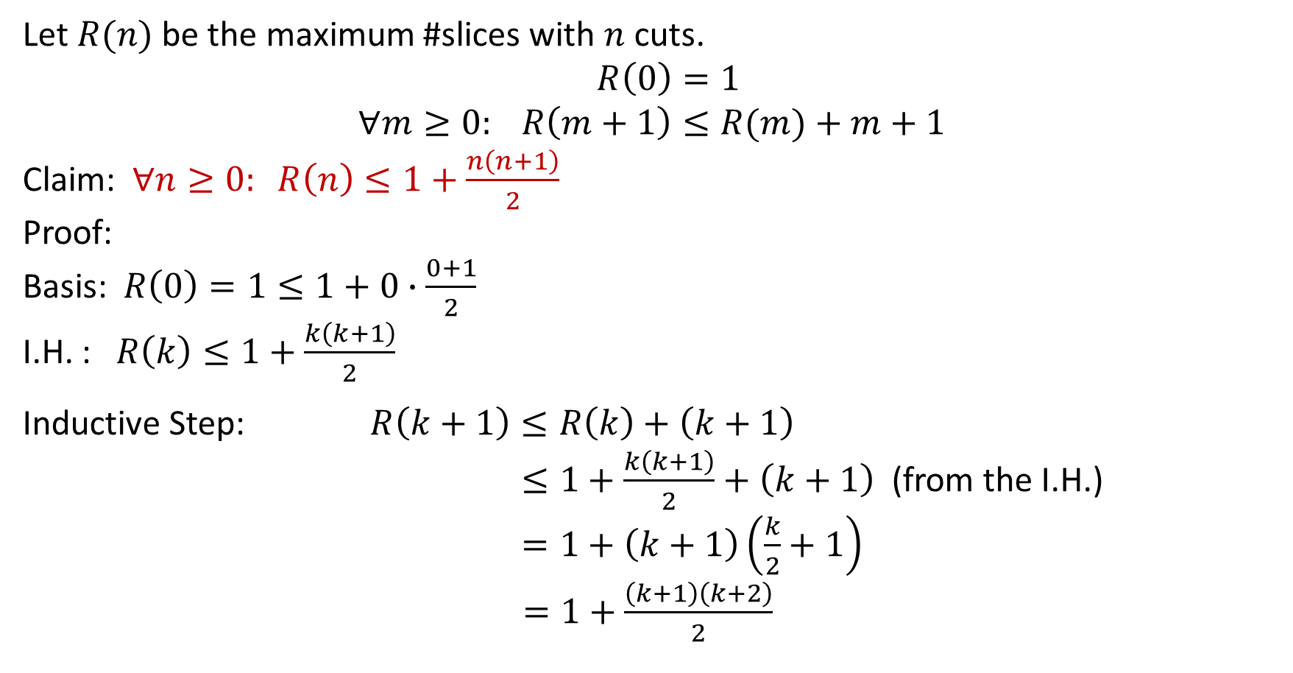
Putting it all together
Let $R(n)$ be the maximum #slices with $n$ cuts.
$$R\left(0\right)=1 \\ ∀m≥0: R\left(m+1\right)≤R(m)+m+1$$
Claim: $∀n≥0: R\left(n\right)≤1+\frac{n\left(n+1\right)}{2}$
Proof:
Basis: $R\left(0\right)=1≤1+0∙\frac{0+1}{2}$
I.H. : $R\left(k\right)≤1+\frac{k\left(k+1\right)}{2}$
Inductive Step: $R\left(k+1\right)≤R\left(k\right)+\left(k+1\right)$ $≤1+\frac{k\left(k+1\right)}{2}+\left(k+1\right)$ (from the I.H.) $=1+\left(k+1\right)\left(\frac{k}{2}+1\right)$ $=1+\frac{\left(k+1\right)\left(k+2\right)}{2}$

Slide 19
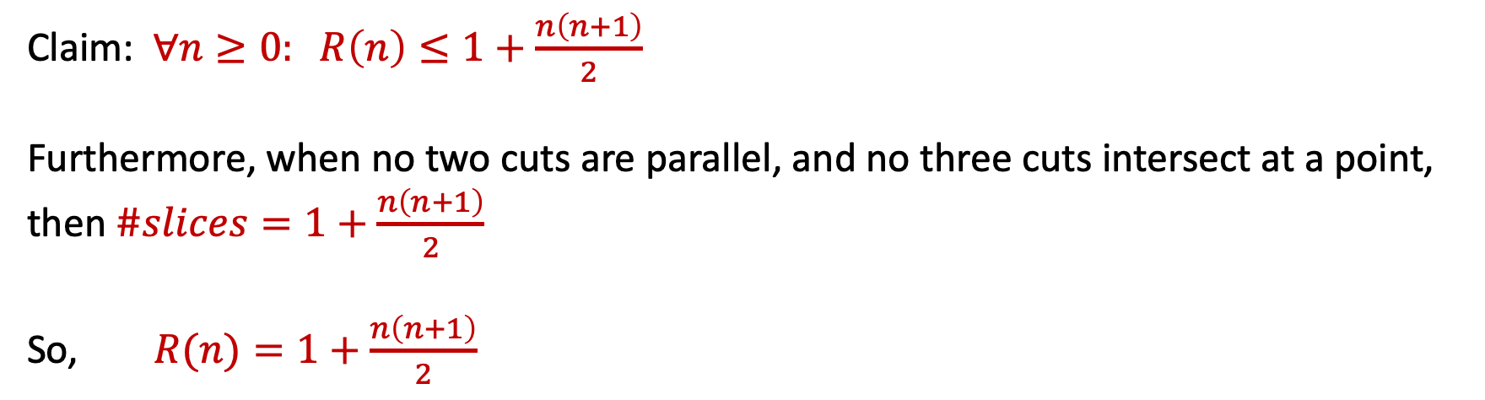
Putting it all together
Claim: $∀n≥0: R\left(n\right)≤1+\frac{n\left(n+1\right)}{2}$
Furthermore, when no two cuts are parallel, and no three cuts intersect at a point, then $\#slices=1+\frac{n\left(n+1\right)}{2}$
So, $R(n)=1+\frac{n\left(n+1\right)}{2}$

Slide 20
The Dinner Party Puzzle
Mr. and Mrs. Smith hosted a dinner party for 9 other couples.
During cocktails, some people shook hands.
No one shook his or her own hand.
No two people shook hands twice.
No one shook their spouse’s hand.
During dinner, Mr. Smith asked everyone how many hands they shook.
He got back 19 different answers.
How many hands did Mrs. Smith shake?

